Slide 1
Combined Control Law & Estimator
Separation principle
What is D(z) ?
Example

Slide 2



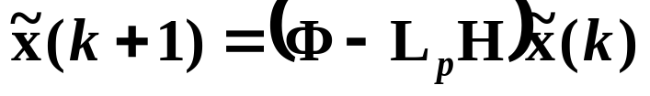


Combined Control Law & Estimator
When all states are measured, the control law design is:
But if not all states are measured, or measurements are noisy, design a state estimator with desired estimator error dynamics:
and then use:
But state feedback was designed assuming x is fedback, not .
Is it really okay to feedback ?
Or do we need to completely redesign K, taking into account now that we are feeding back x and not ?

Slide 3















Block Diagram of Combined Control & Estimator System
Σ
Σ
Σ

Slide 4

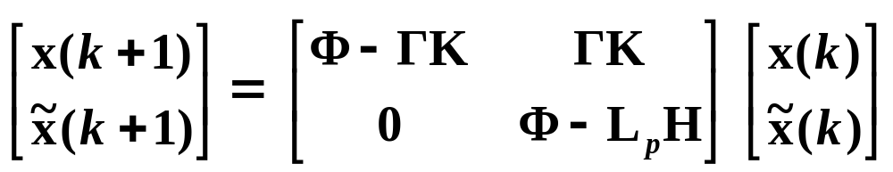
Analysis of the Combined Control & Estimator System with Fedback
along with estimator error dynamics equation:
yields the overall system dynamics
(control and estimator):

Slide 5
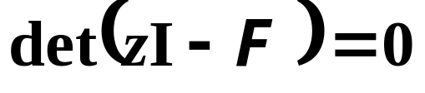
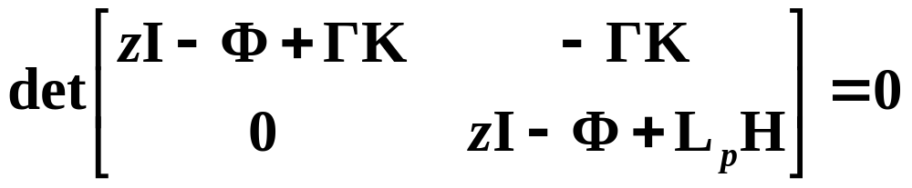
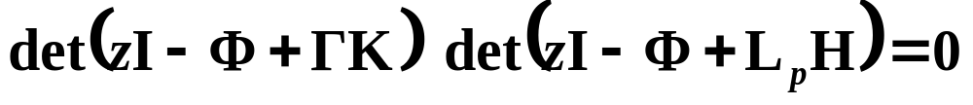
Overall Closed-Loop Characteristic Equation
Poles of the overall closed-loop system:
desired control poles + desired estimator poles
Separation Principle
Controller design and estimator design can be carried out independently.

Slide 6



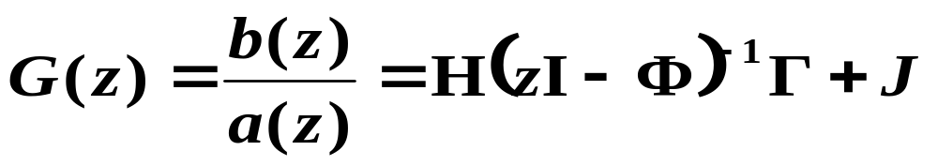
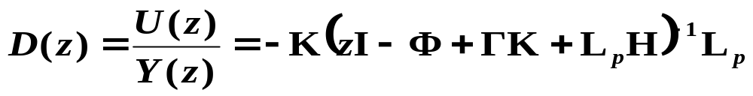
What is D(z) ?
Compare with standard state-space equation:
Compensator transfer function is then:

Slide 7
Comments
Poles and zeros of D(z) are never specified in the state-space compensator (controller & estimator) design.
The compensator D(z) itself may in fact be unstable!
  Overall closed-loop system of plant and compensator is stable for stable controller and estimator designs, but the compensator itself may have unstable poles.
The transfer function D(z) from the state-space controller/estimator design has similarities with compensators designed using Root Locus or Frequency Response/Bode methods.

Slide 8
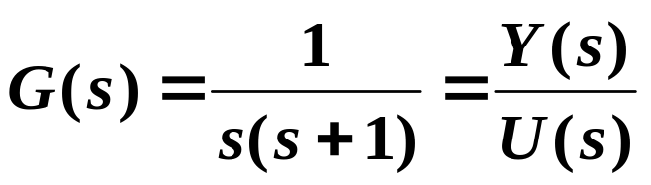

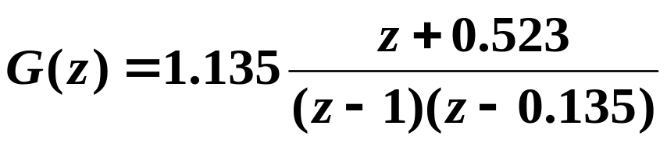
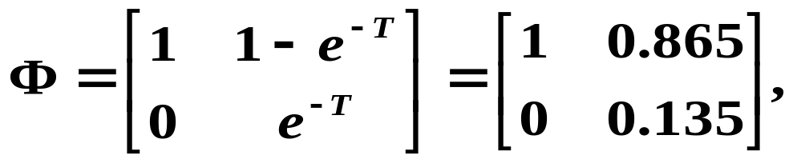
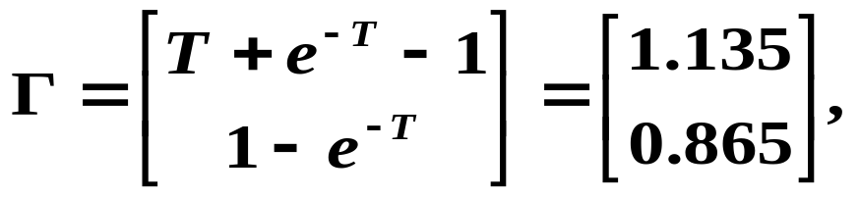


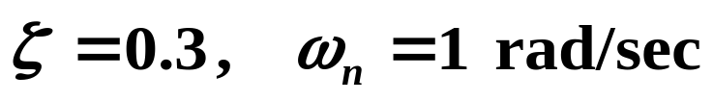

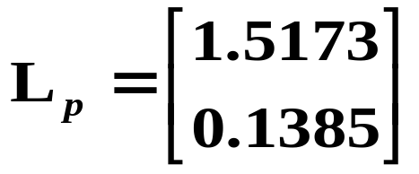
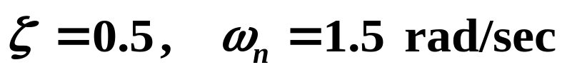
Example
State feedback:
Estimator:
What is the compensator transfer function D(z) ?

Slide 9
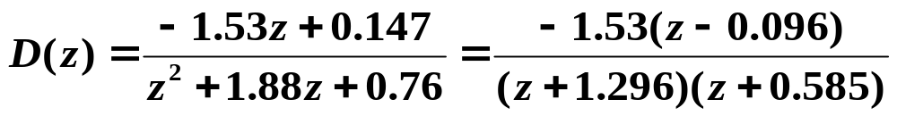
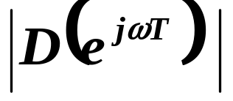

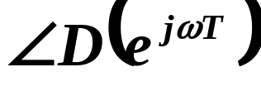
Im(z)
Re(z)
1

